Slide 1

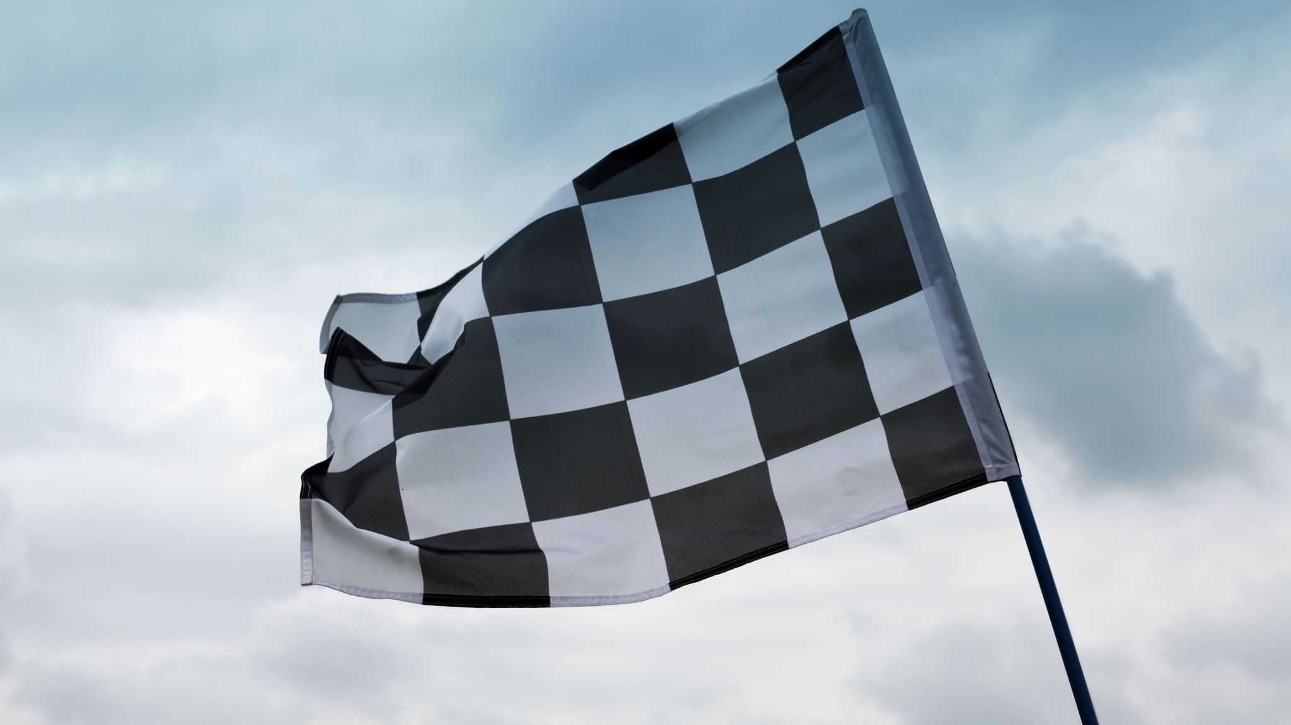
Random Flag Generator
Group 2: Nathaniel Hu, James Park, Akram Hannoufa
Final Presentation
Notes:
Nathaniel

Slide 2
Introduction
Notes:
Nathaniel

Slide 3


Original Open-Source Project
https://github.com/daboth/pagan
PAGAN (Python Avatar Generator for Absolute Nerds)
Uses input strings to randomly generate unique pixel art avatars
Runs input strings through (specified) hashing function to obtain hash digest in hexadecimal form
Grinds hash digest to select avatar colours, elements (i.e. weapons, shield, other equipment)
Saves pixel art avatars to working directory once generated
Notes:
Nathaniel

Slide 4
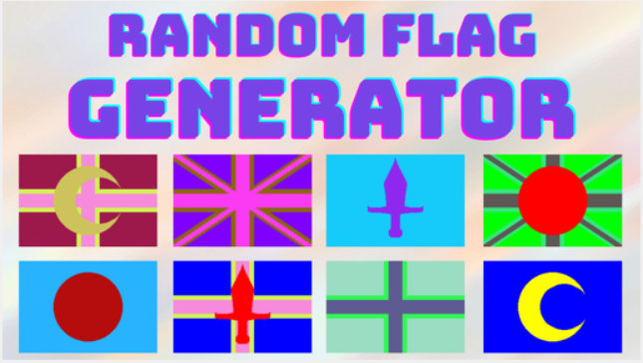
Our Project
Uses input strings to randomly generate unique pixel art flags
User can specify hashing algorithm to be used
Generated flags are saved as .png image files; can be displayed to users
GUI, flag gallery, user control
Notes:
Akram
estimating outcomes
- GUI flag gallery: 2-3 weeks
- improved flag resolution options: 1-2 weeks
- testing: 1-2 weeks
handling uncertainty
- GUI flag gallery: try to finish within 1-2 weeks, 3rd week as buffer time
- improved flag resolution options: try to finish within 1 week, 2nd week as buffer time (relatively straightforward)
- testing: try to finish within 1 week, 2nd week as buffer time (relatively straightforward)

Slide 5
Improvements
Notes:
James

Slide 6
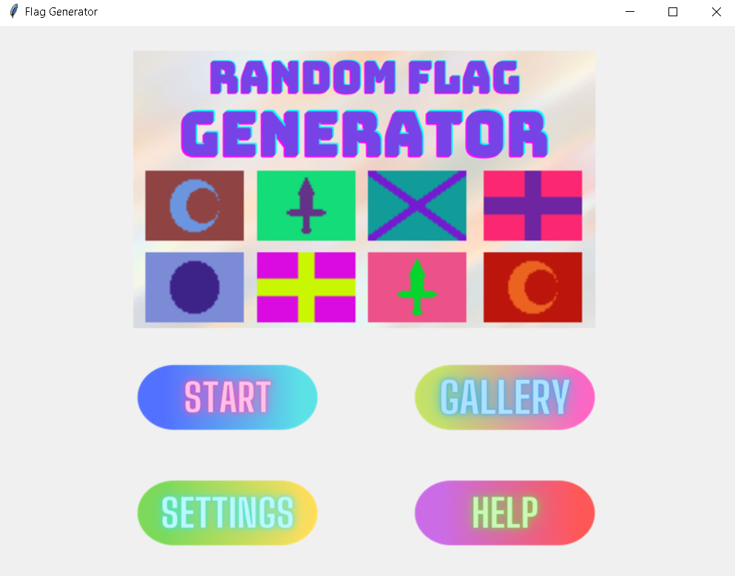
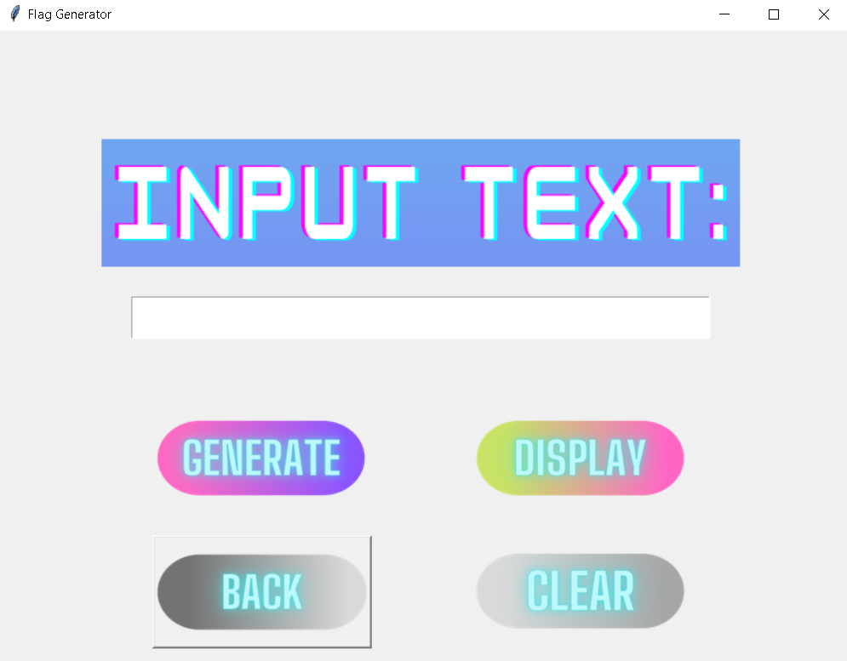
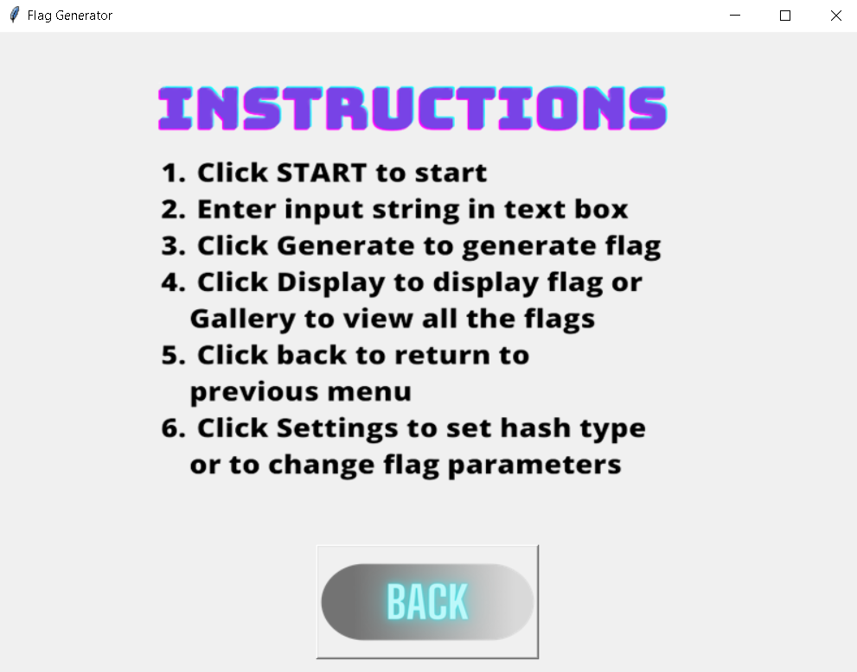
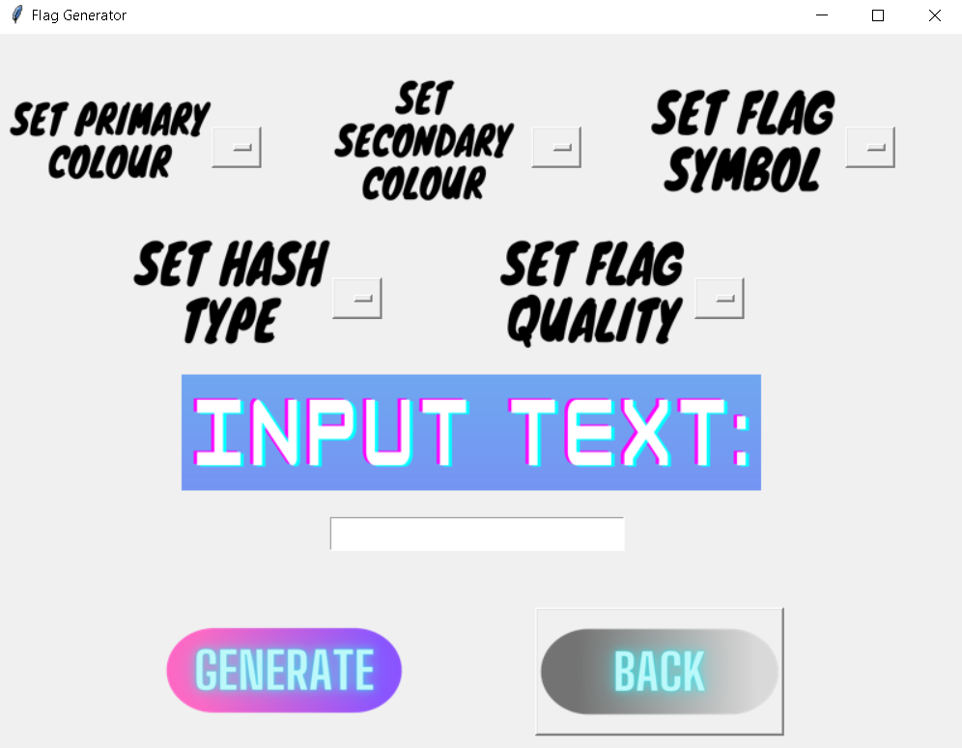
Improvements - GUI
Implemented a GUI
PAGAN purely command line
Start, Settings, Gallery, Help
Notes:
James

Slide 7
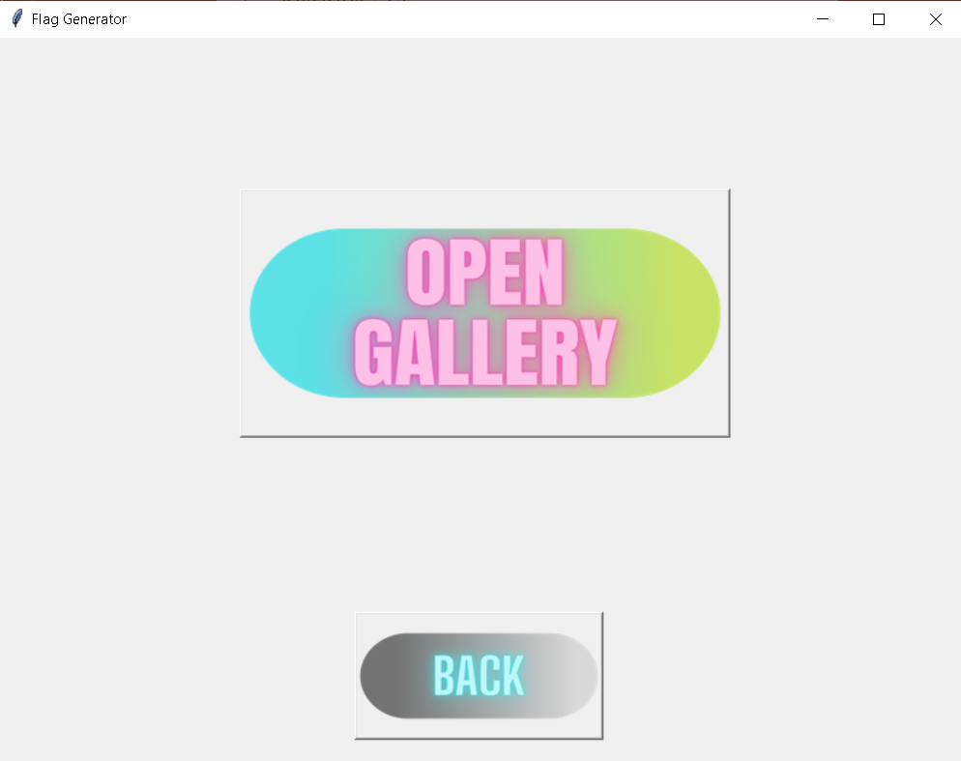

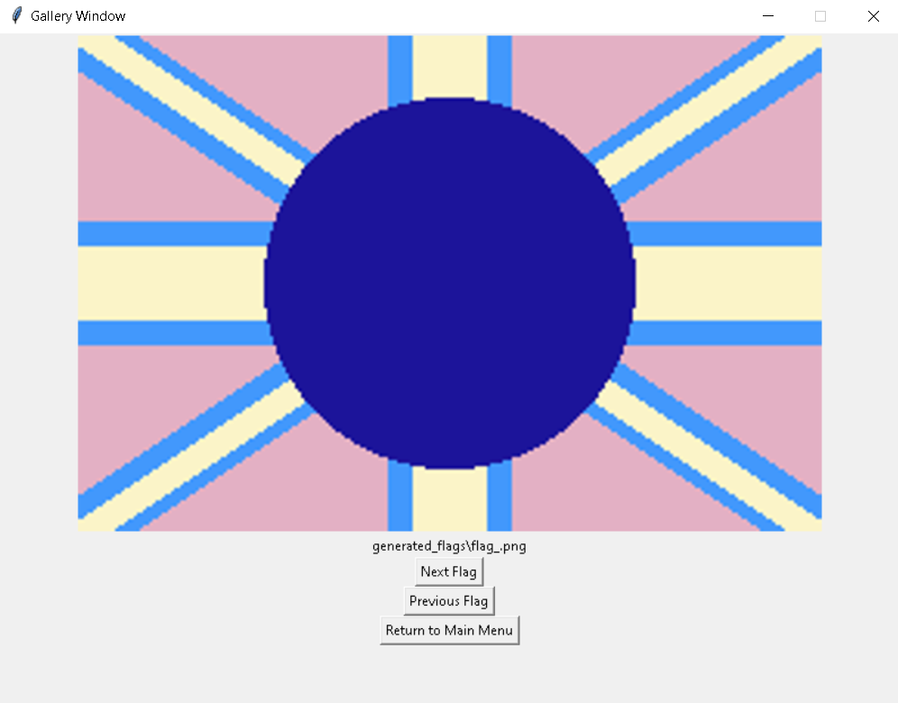
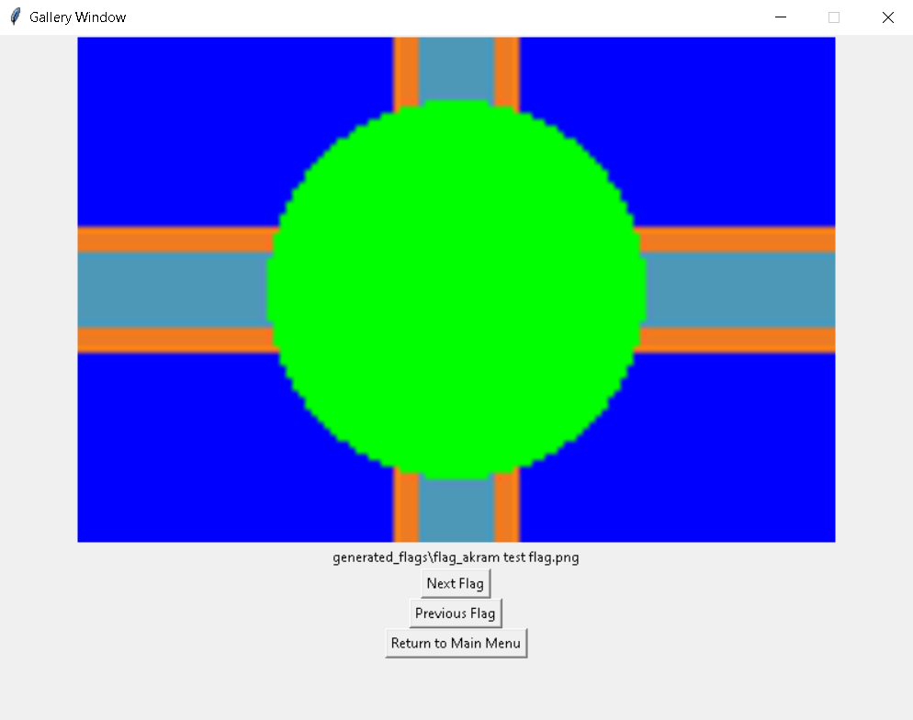
Improvements – Flag Gallery
User flag gallery
See generated flags
Notes:
James

Slide 8
Improvements - Testing
Source code: 11 test cases
Implemented 65+ test cases
Used the pytest framework to develop unit tests for all functional modules
Performed manual and user validation testing on the GUI
Notes:
Akram

Slide 9
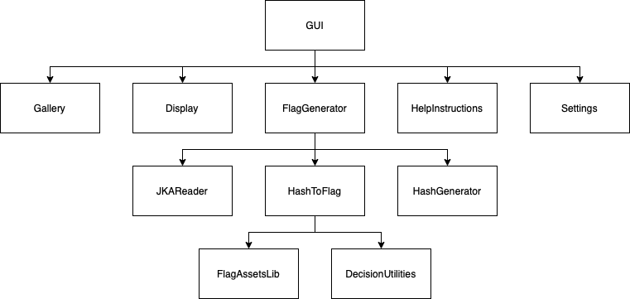
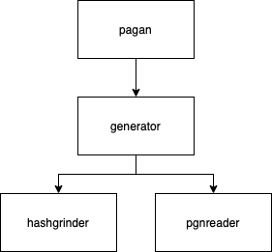
Improvements - Modularity
Improved modularity
Improved readability, maintainability, low coupling, high cohesion
Notes:
Nathaniel
reorganized/refactored modules
generator.py -> FlagGenerator.py and HashGenerator.py
hashgrinder.py -> HashToFlag, FlagAssetsLib.py and DecisionUtilities.py
pagan.py -> FlagGenerator.py
pgnreader.py -> JKAReader.py
doing so improved the readability and maintainability of each module, as each module was more cohesive, with only related functions and variables, methods and attributes in each
there was also lower coupling between modules, as changes to one module's interface would only require making a few changes to its uses in at most one other module; internal functional changes do not require changes to other modules using those modules
also makes it easier to add/expand program functionality by either adding new modules and integrating them in a similar manner to existing modules, or expanding on existing modules (better separation of concerns between modules)

Slide 10

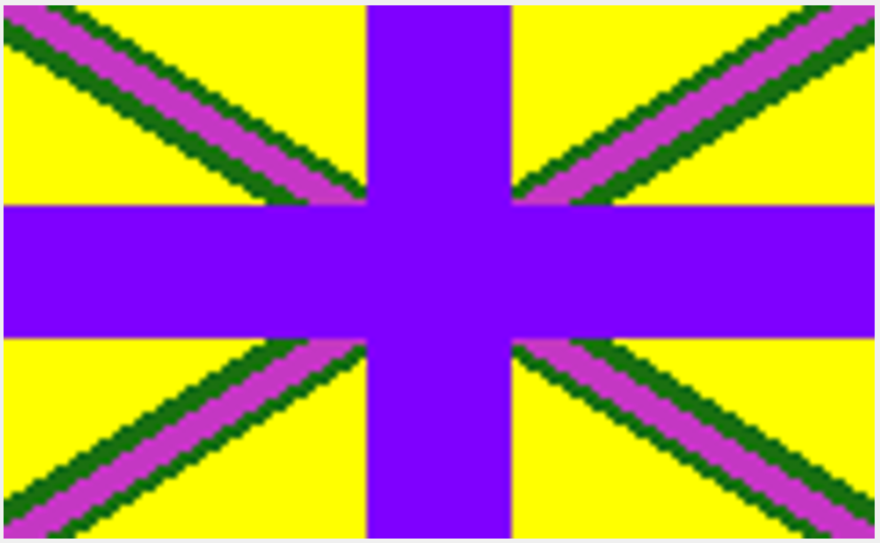
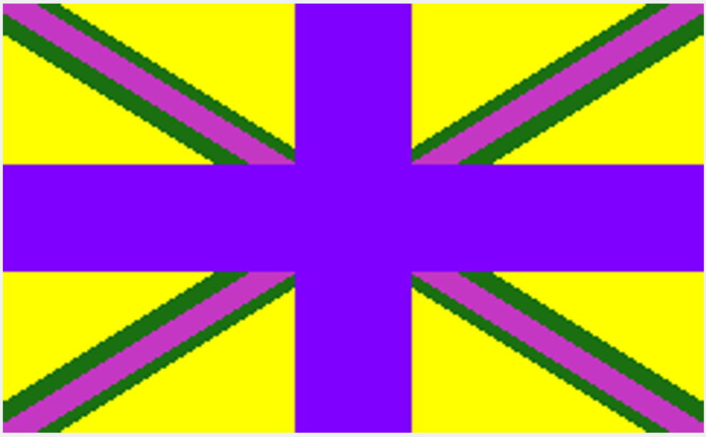
Improvements – Asset Options
Low
More asset options
Resolution options
Mid
High
Notes:
Nathaniel
Added more asset options: for base and overlay strip styles, symbol types and colours
Added in three resolution options:
Low: 60 x 40 pixels
Mid: 120 x 80 pixels
High: 240 x 160 pixels
Gives a sufficiently large variety of different flags that can be created, along with different resolution options for the user to choose from

Slide 11
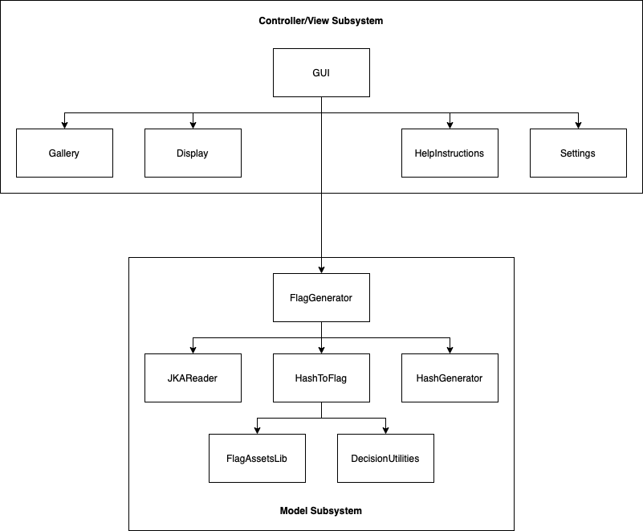
Architecture
The Random Flag Generator uses the MVC-I architecture
Controller/View Subsystem
Model Subsystem
Low Coupling and High Cohesion between modules
Notes:
Nathaniel
The Random Flag Generator uses the Model-View-Controller Architecture, Variant I
This MVC-I architecture includes the following two subsystems:
Controller/View: handles I/O processing and interfacing, and attaches to the data module
Model: handles core functionality and data, notifies Controller/View subsystem of any data changes (i.e. new flags generated) in Model subsystem
There is low coupling and high cohesion between modules and subsystems, and makes it easier to add/expand and maintain program functionality, change/update interface views

Slide 12
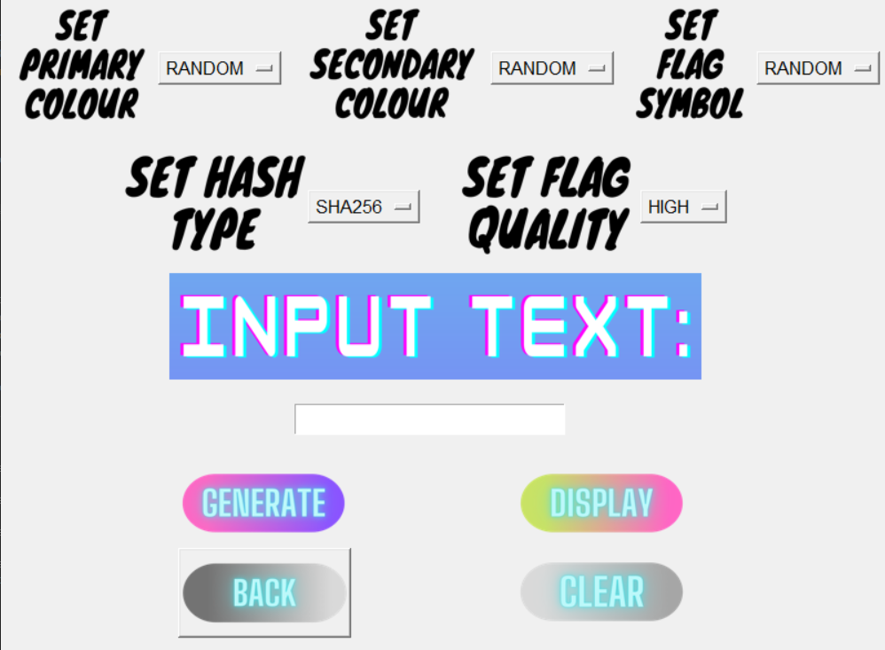




Software Qualities
Maintainability
Enhanced modularity --> Easy addition of new assets/qualities
Portability
Python runnable on most platforms
User-friendliness
UI for easier generation, settings, gallery
Avoids purely command line interaction
Help page
Notes:
Akram

Slide 13







Example Flags
demo123
123 456 789
Jakriel
@!,.%
sample
3XA3 is a fun course
Notes:
Akram

Slide 14
Demo
Notes:
Akram

Slide 15
Future Improvements
Online version
Select file save location and file type (png, jpeg, psd, pdf, tiff)
Wider array of assets (more symbols, colours, sizes)
More hashing algorithms
More user control over output (within reason)
Allow for different inputs (keyboard: enter, esc)
Revamp GUI (better visuals, effects, animations)
Notes:
James

Slide 16
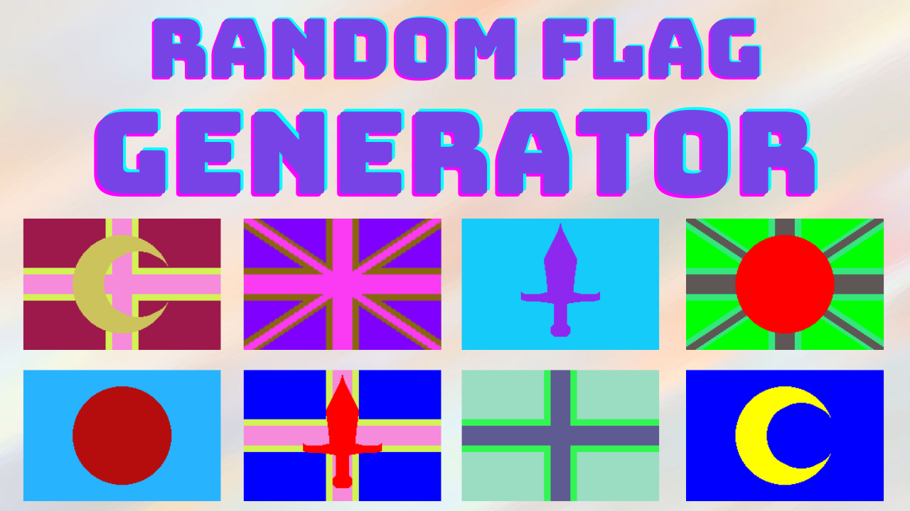
Conclusion
Notes:
Akram

